Slide 1
Crazy Rich Asians
Team Kentucky
김동환, 김효찬

Slide 2


Slide 3
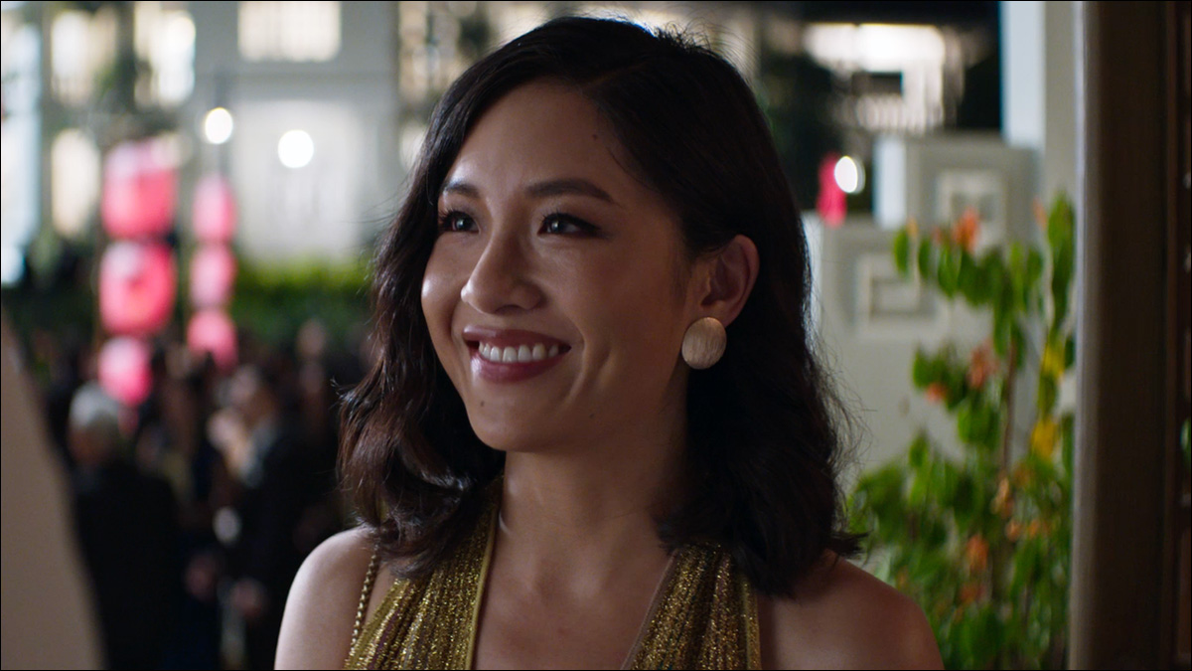

Slide 4
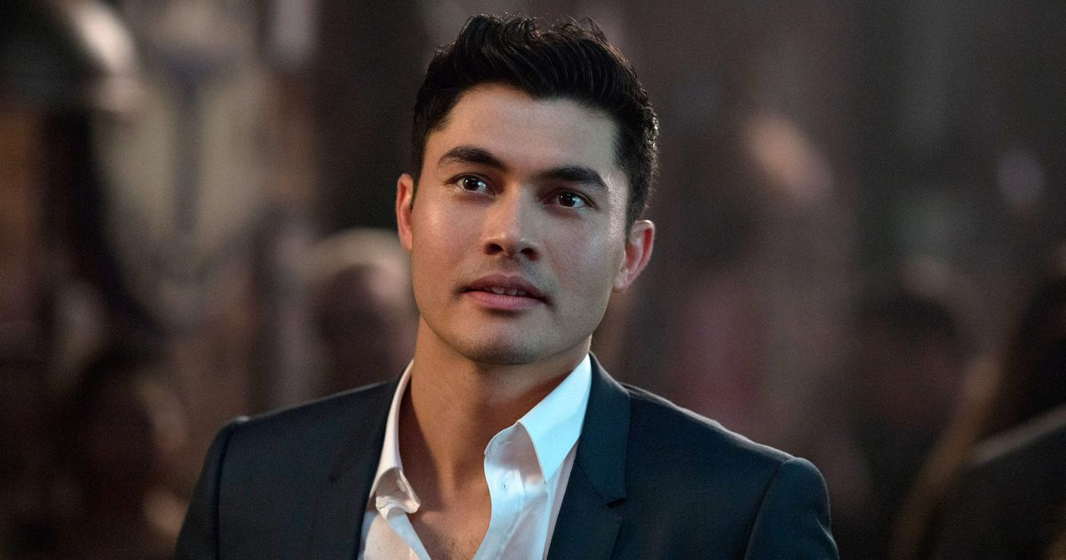

Slide 6
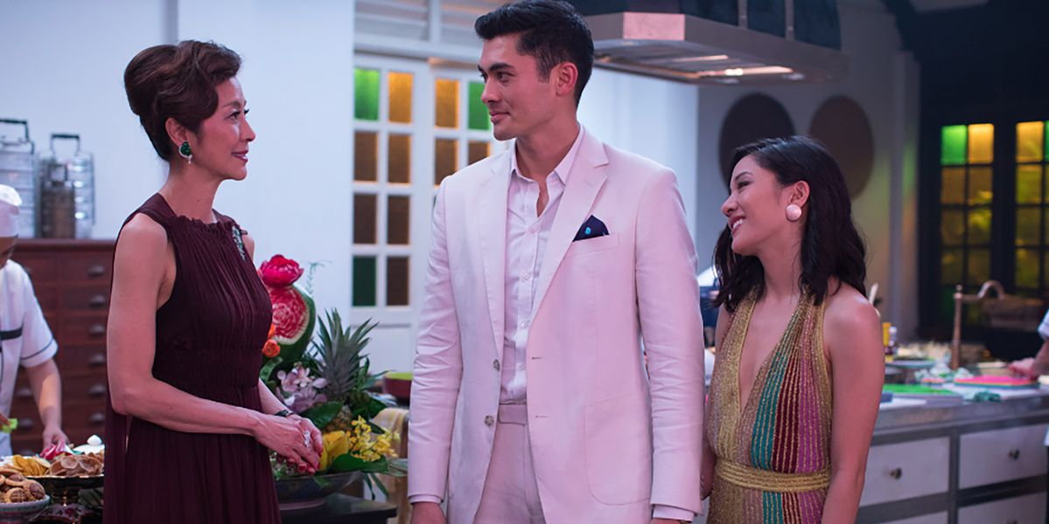
competition and work ethic

